Slide 1
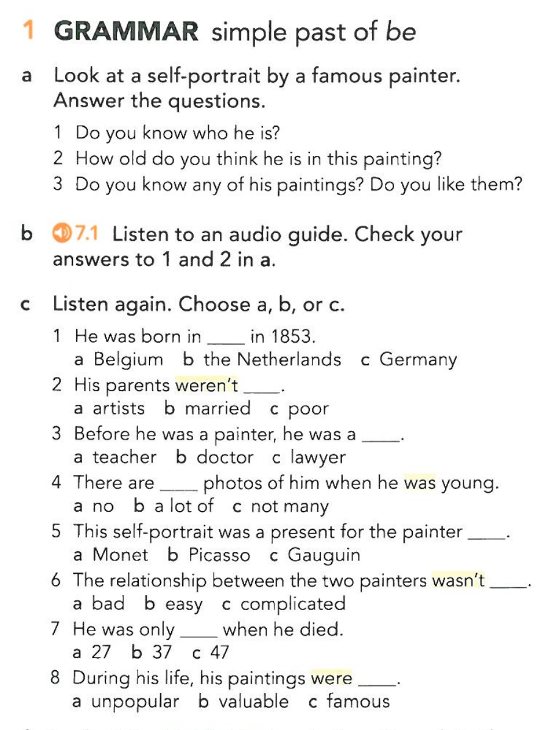
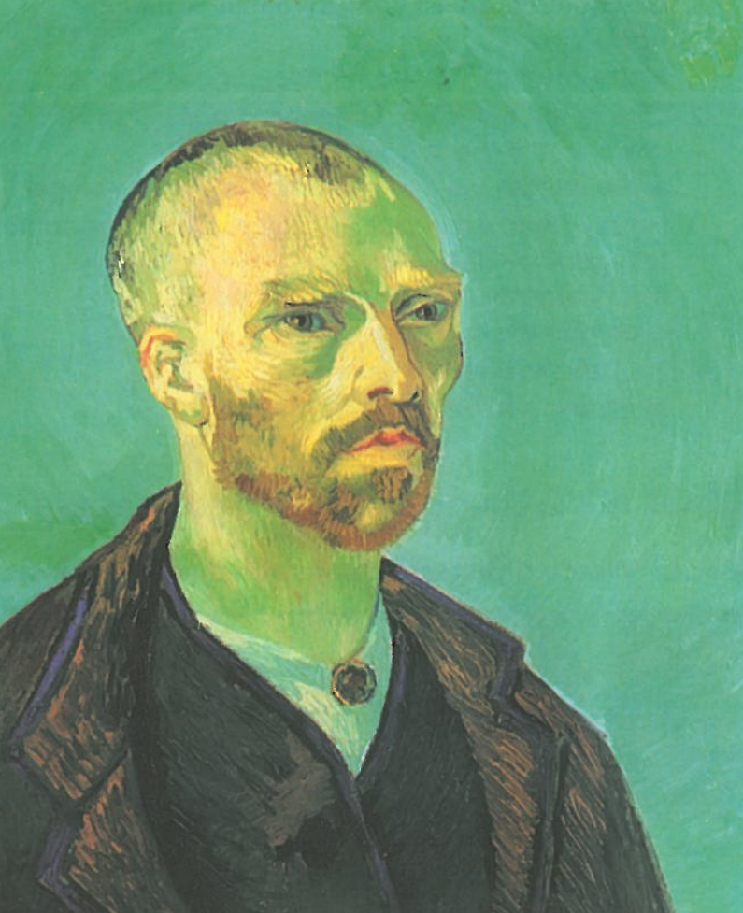

Slide 10
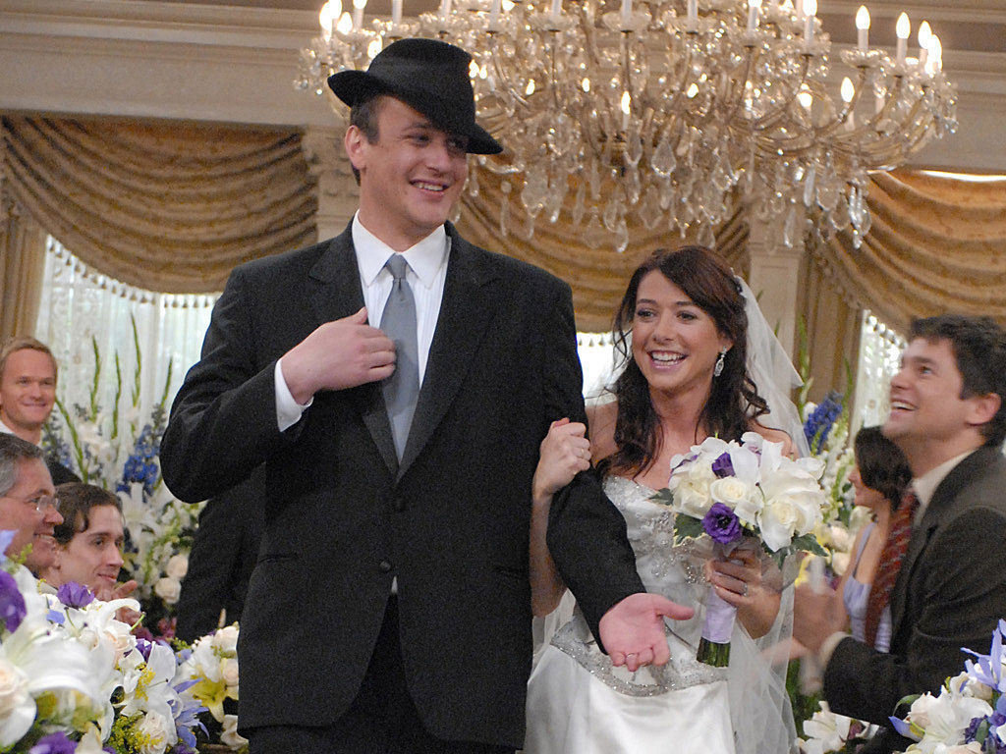
Married

Slide 11
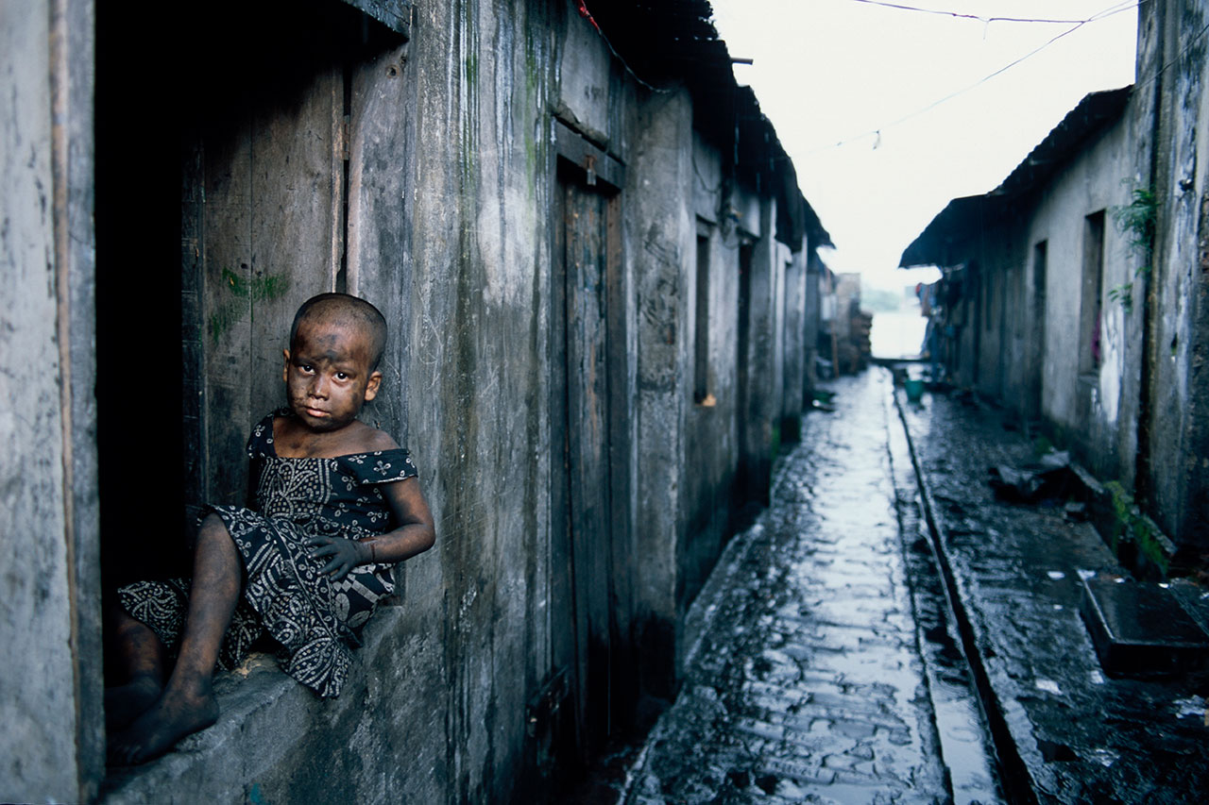
Poor

Slide 12
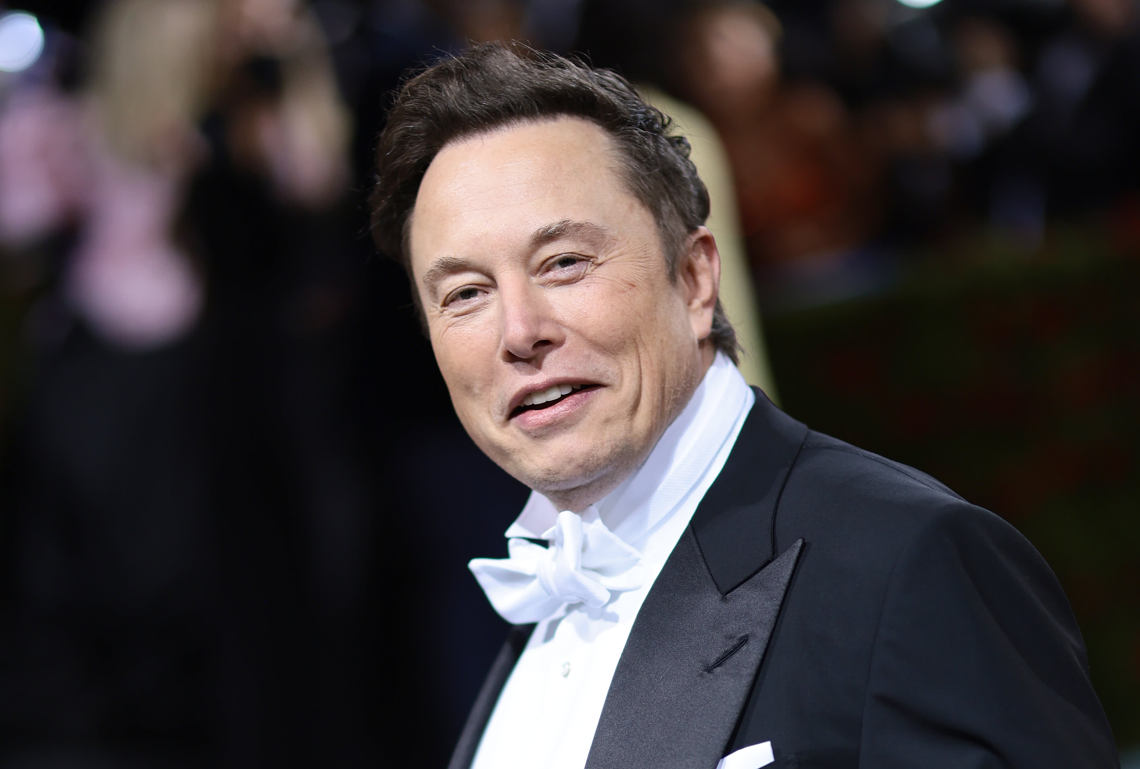
Rich = Poor

Slide 13

Lawyer

Slide 14
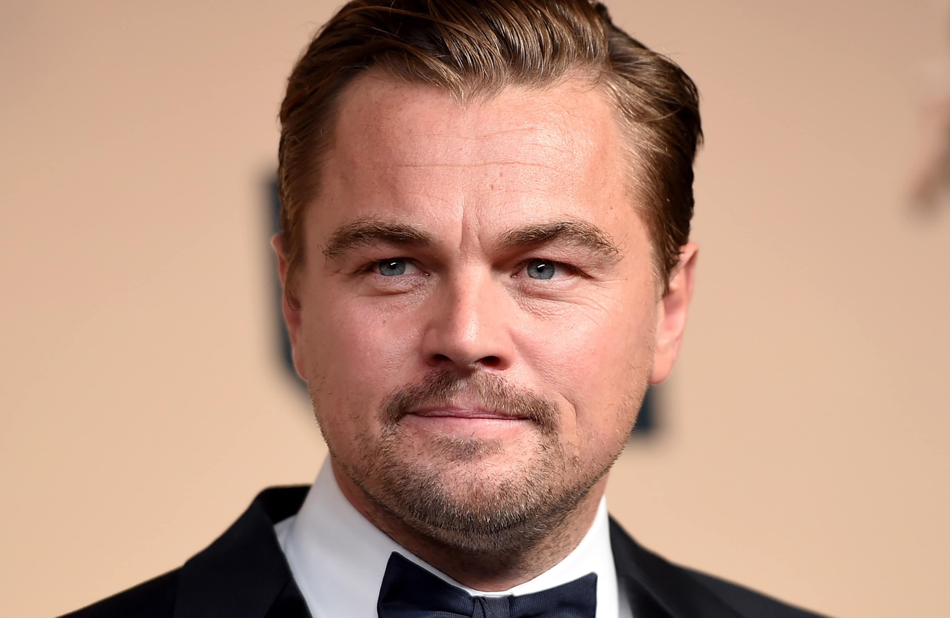
Popular

Slide 15

Valuable

Slide 16
was / were

Slide 17


Ronaldo is in Manchester
Ronaldo was in RM

Slide 18
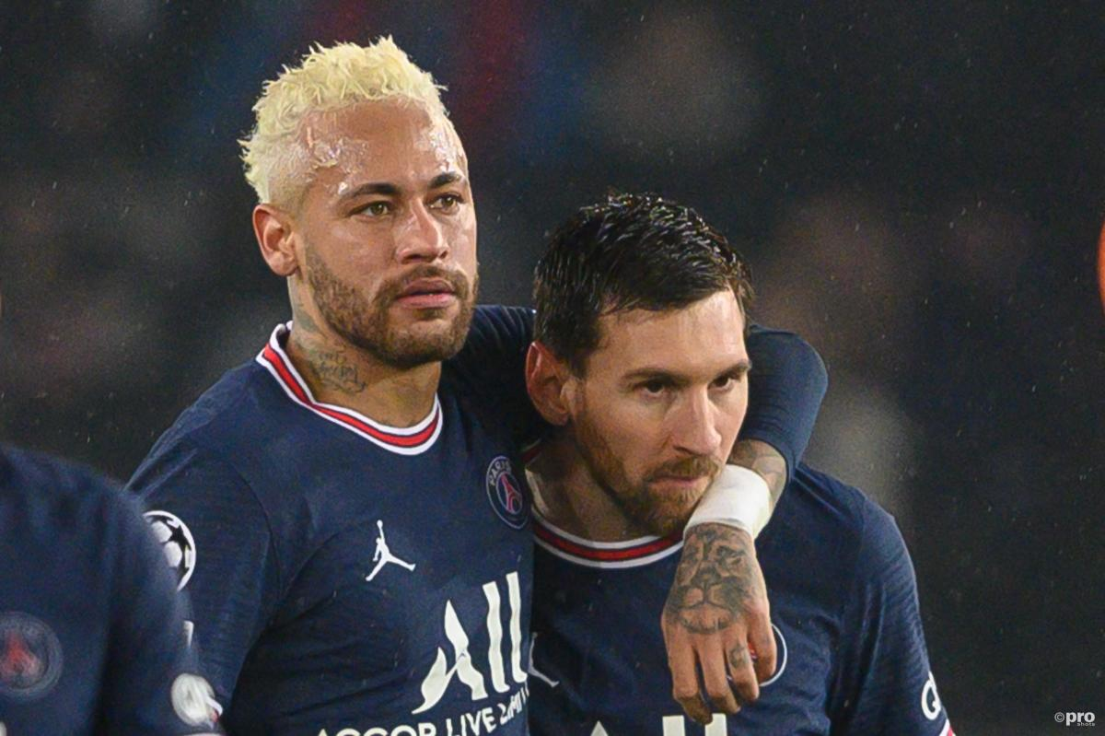
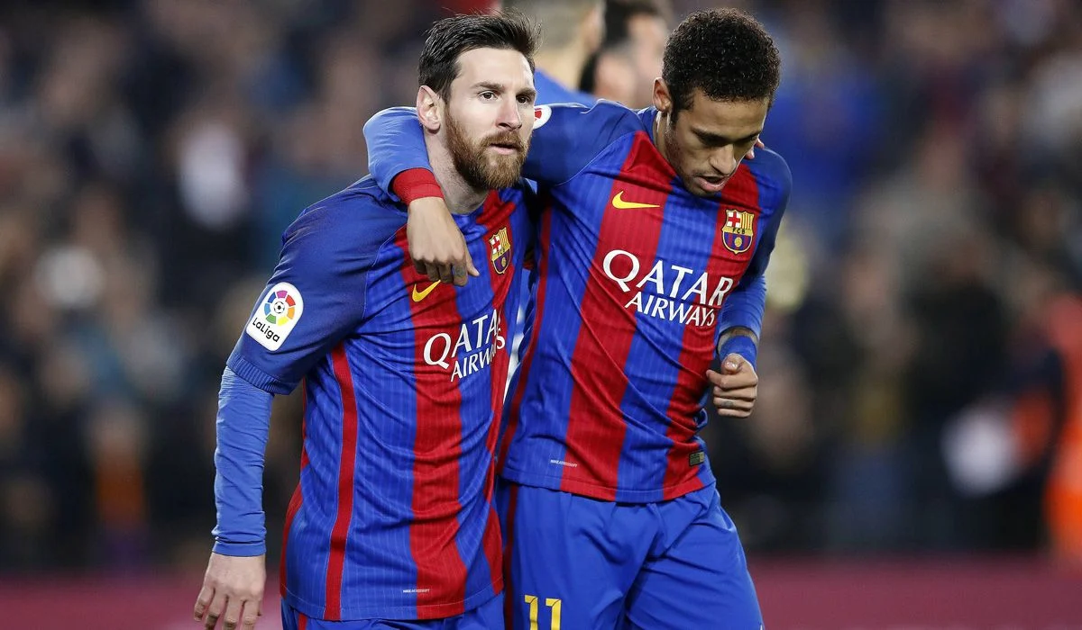
They were in Barcelona
They are in PSG

Slide 19
is | are | isn’t | aren’t

Slide 20
is | are | isn’t | aren’t
was

Slide 21
is | are | isn’t | aren’t
was | were

Slide 22
is | are | isn’t | aren’t
was | were | wasn’t

Slide 23
is | are | isn’t | aren’t
was | were | wasn’t | weren’t

Slide 24
